Slide 1
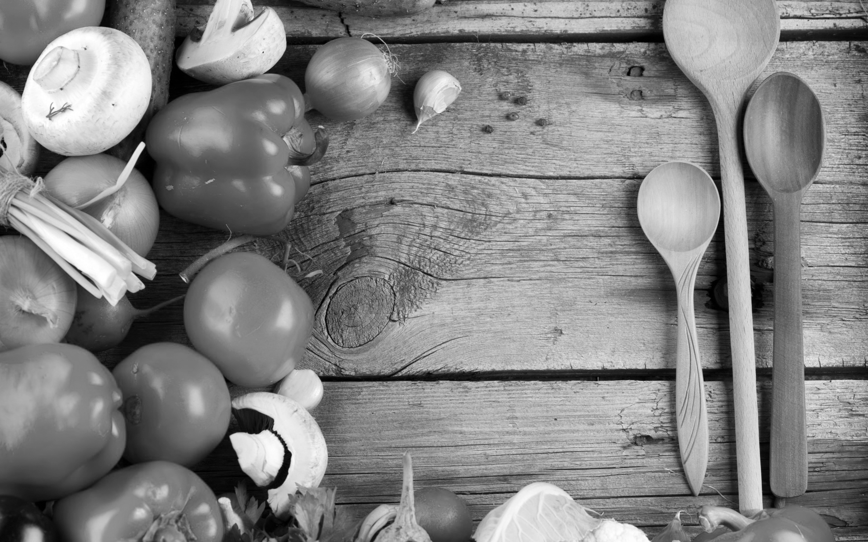

Digital Company
Irina Spac
Damir Dželilovic
Martina Mikušiakova
Lea Mackova
Bia Muresan

Slide 2
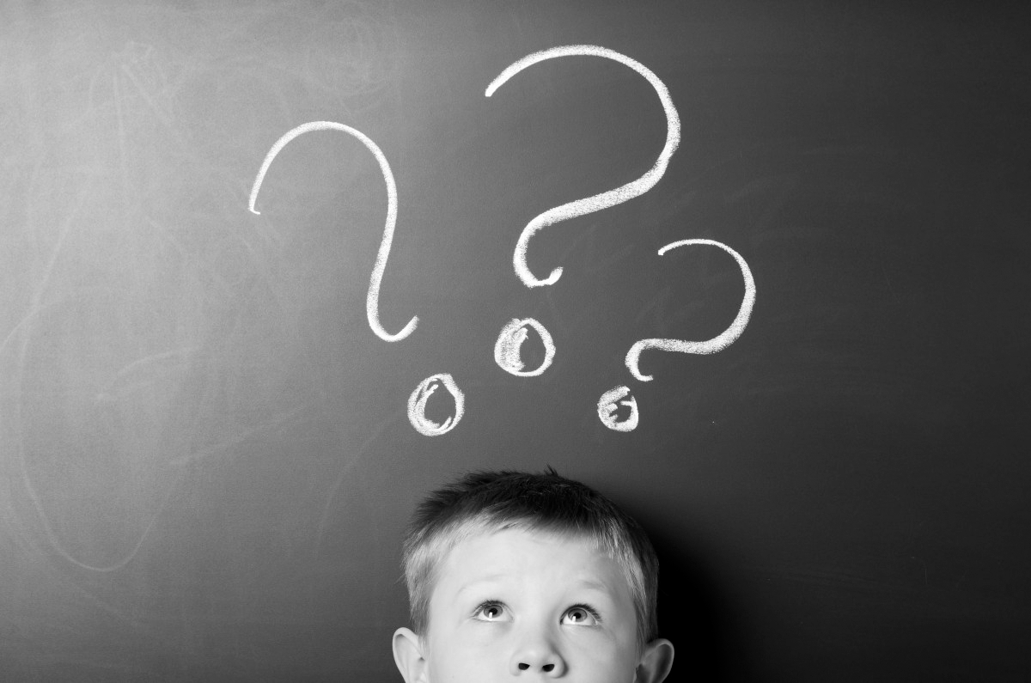
WHO ARE WE ?
a digital company that aims to connect people through food

Slide 3
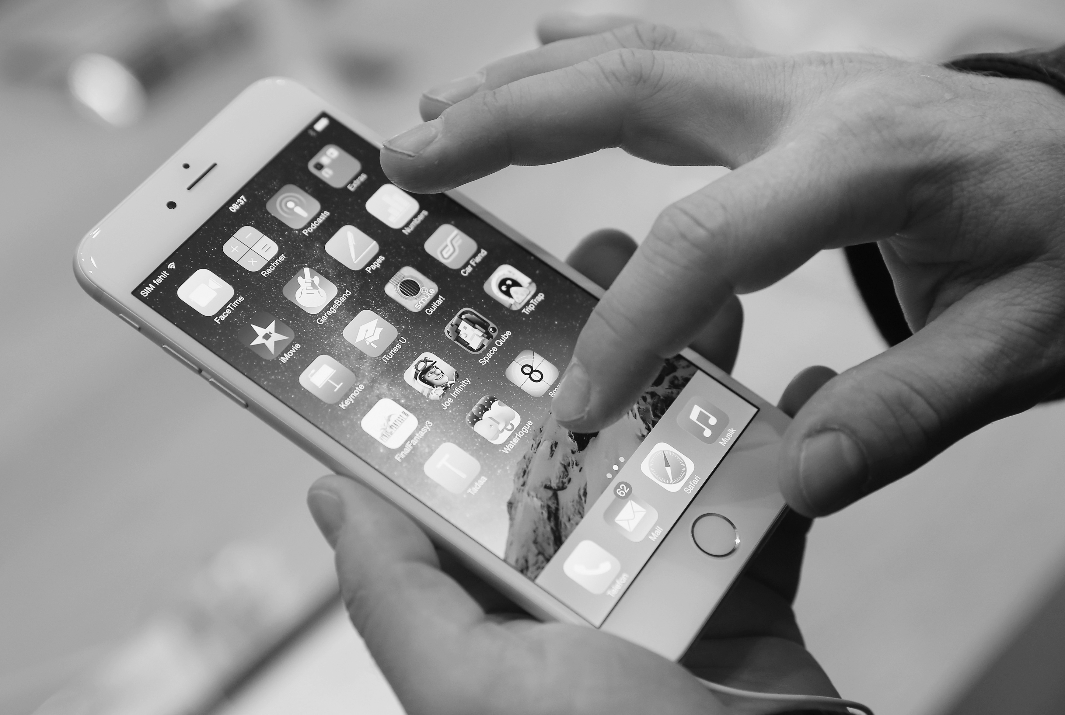
HOW ?
Through an app that connects two types of users:
those who search for homecooked meals
those who prepare and sell food from their homes.

Slide 4
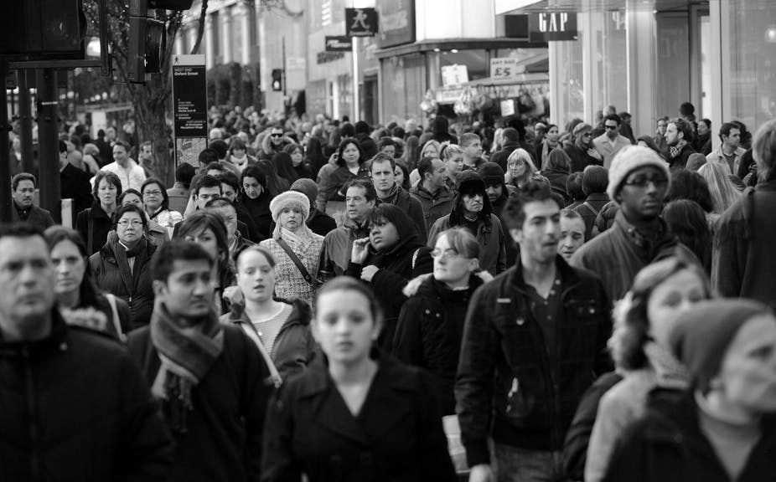
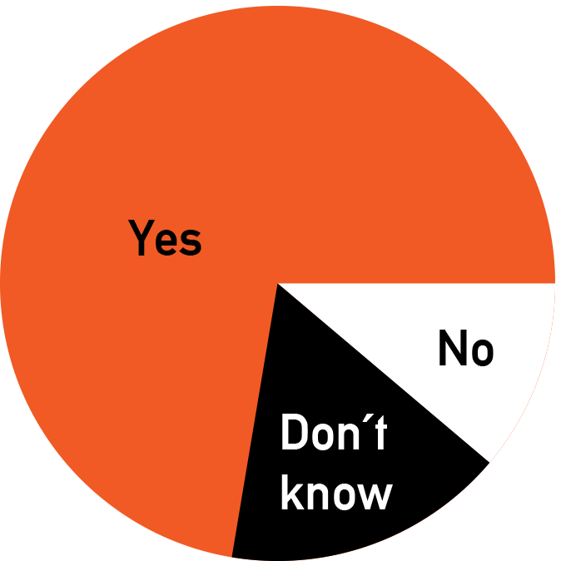
WHO WILL USE THE APP?
THE MAKERS :
Housewifes
Senior Citizents
Would you buy homecooked food from nearby your place?
THE TAKERS :
-Students
-Men (Bachelors)

Slide 5
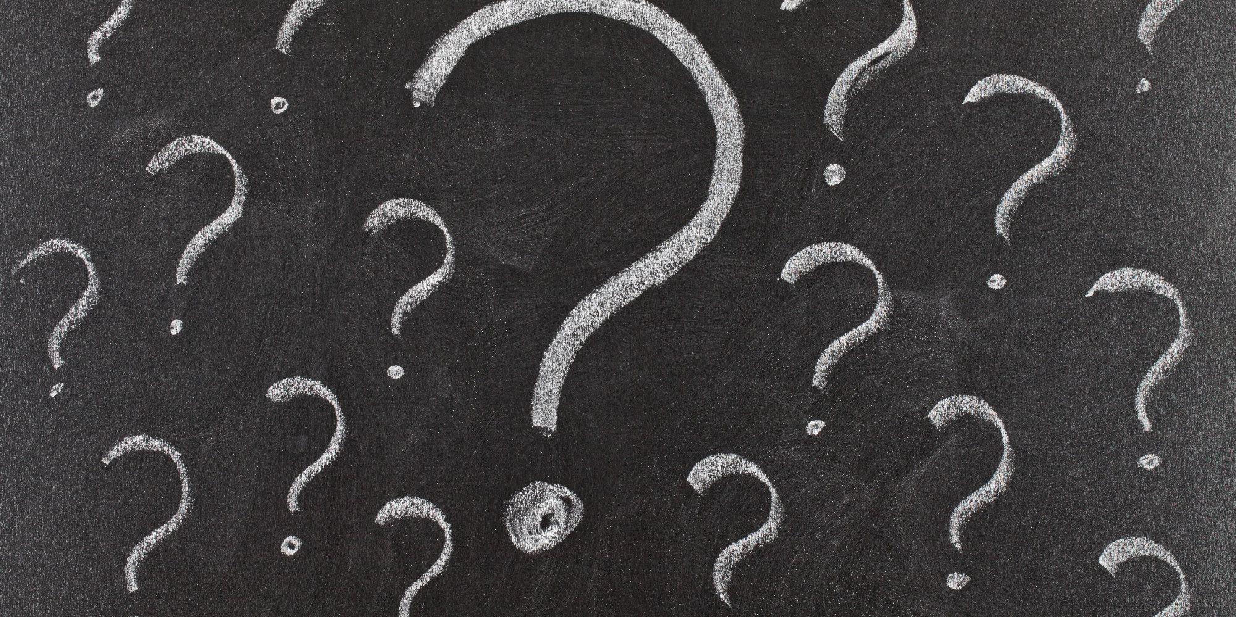
Why is our service needed ?
lack of time, resources or cooking skills
source of income
feedback on cooking skillis
opportunity to socialize & try new cuisines
waste-free trends
inexpensive alternative

Slide 6
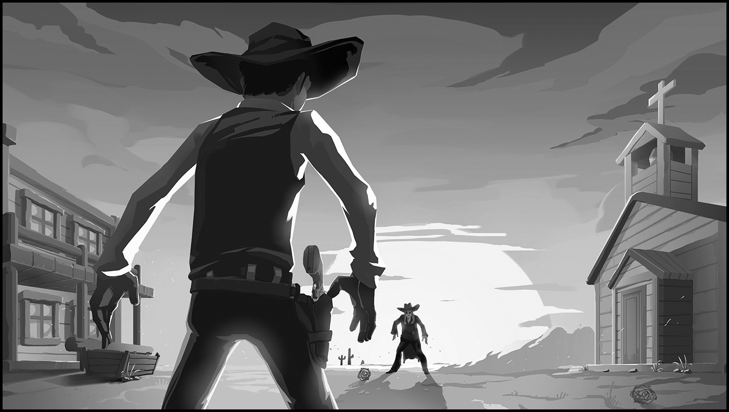
COMPETITON
Few similar concepts
No functional app
No real competition
Market opportunities

Slide 7
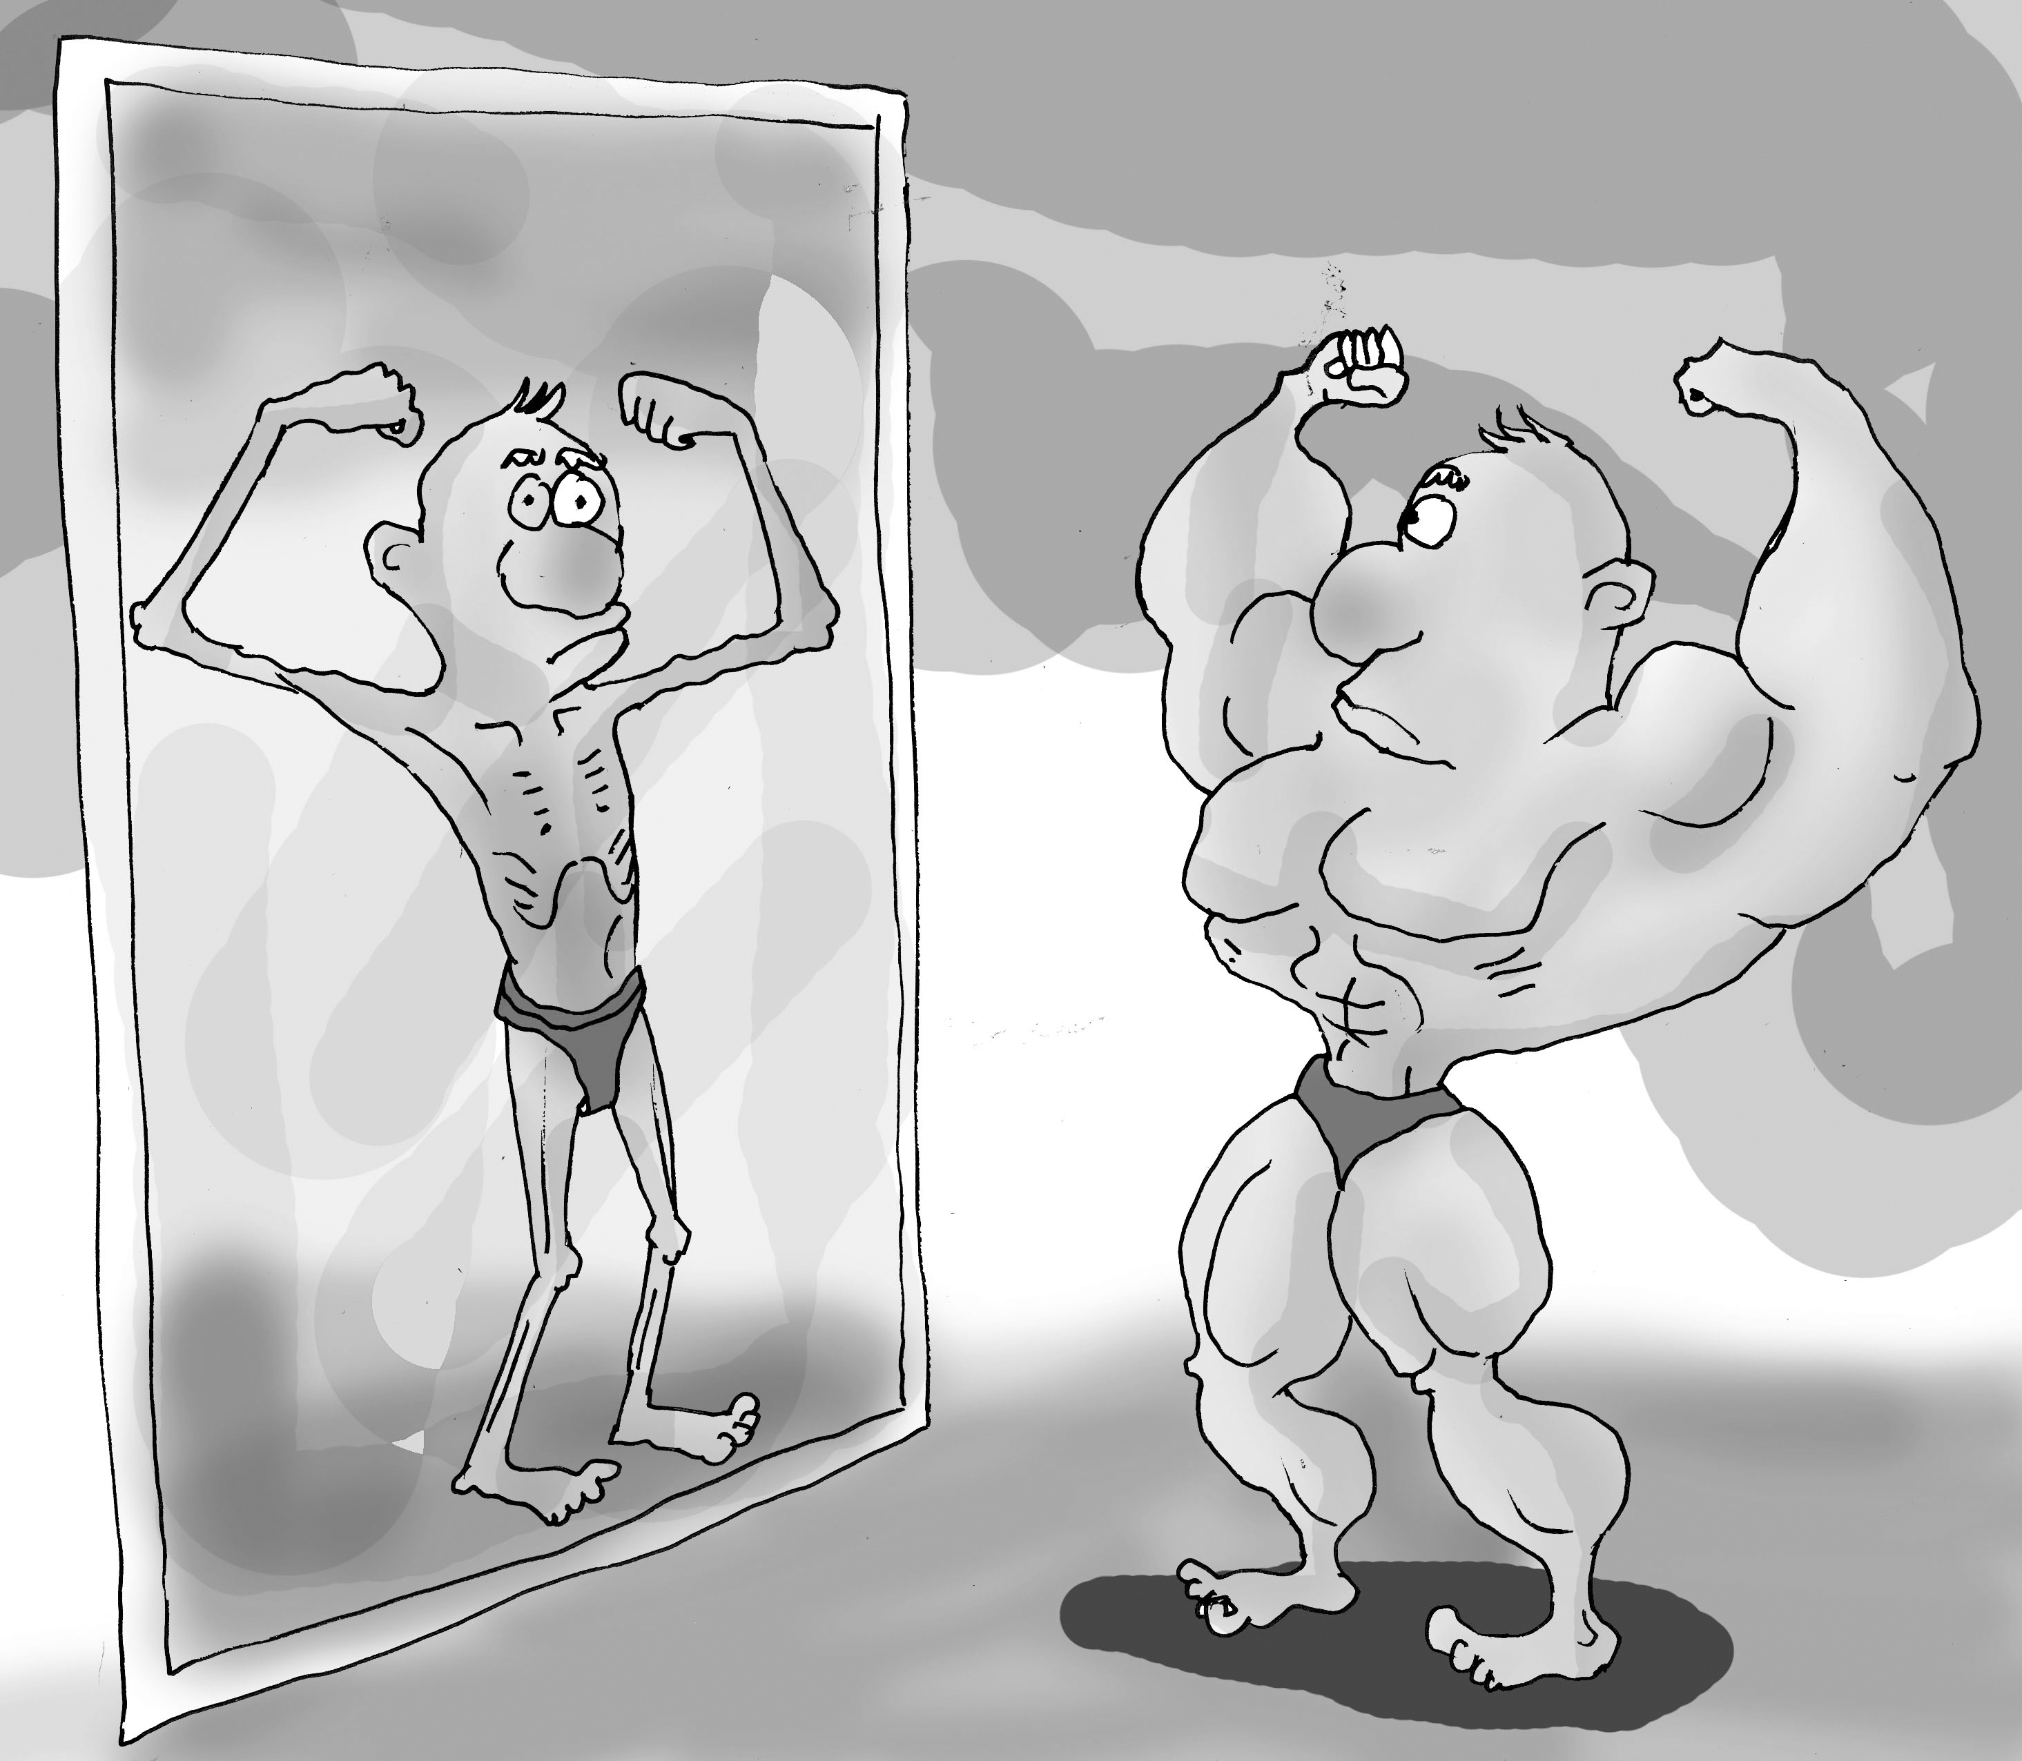
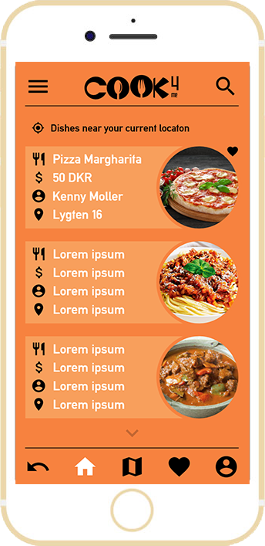
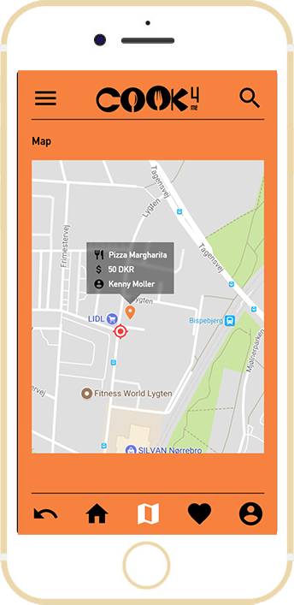
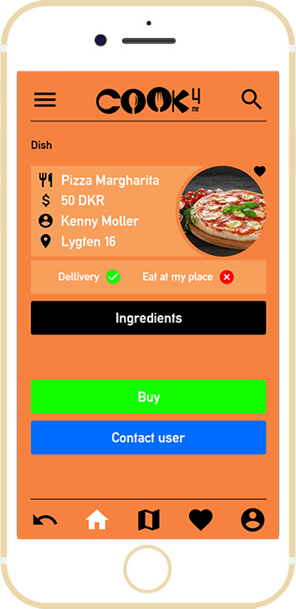
VISUAL IDENTITY
accessible design
visual impact on your food perception

Slide 8
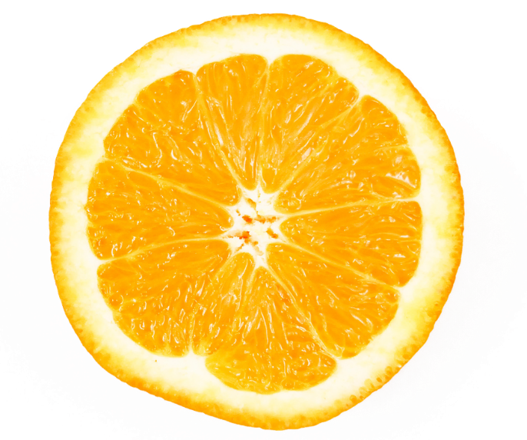

COLOR SCHEME
Orange - stimulates appetite in general, also happiness, warmth...
Color contrast between black and orange sets the mood of the app, establishes identity and increases legibility

Slide 9
LOGO
self-explanatory
gastronomical image
modern and simple

Slide 10


Slide 11
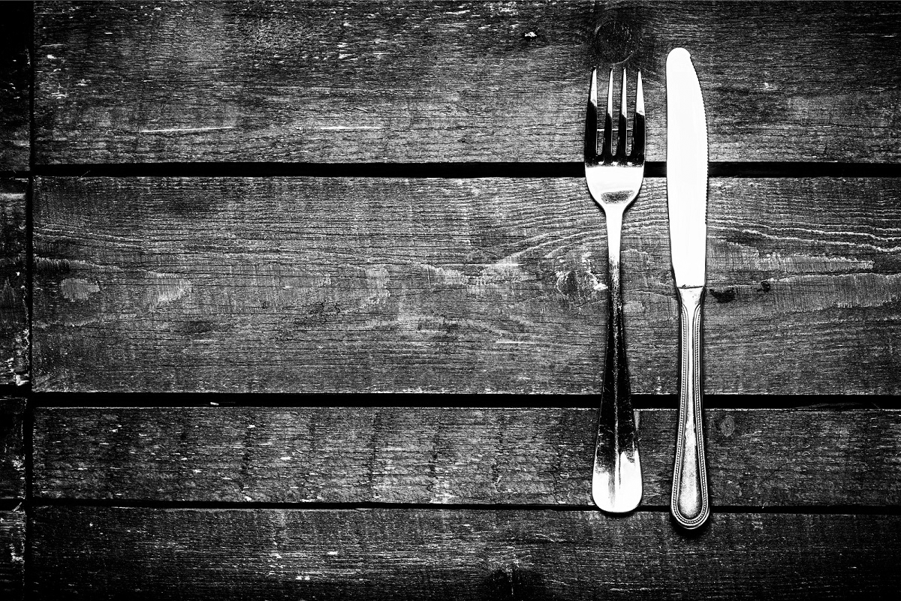
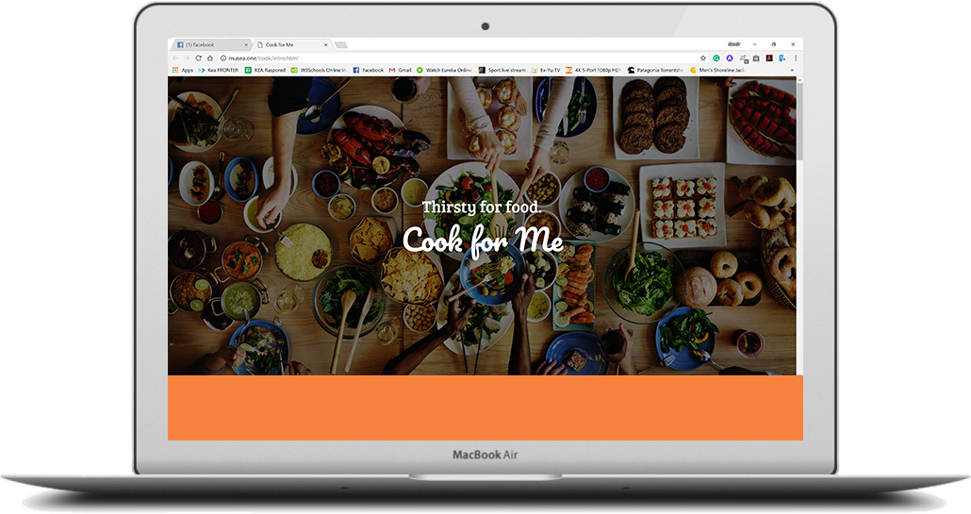
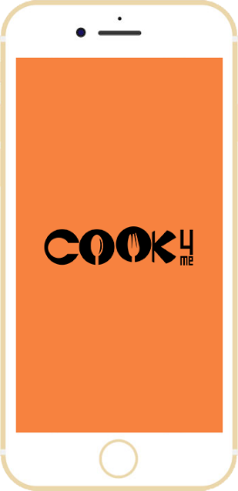
APP & WEBSITE

Slide 12
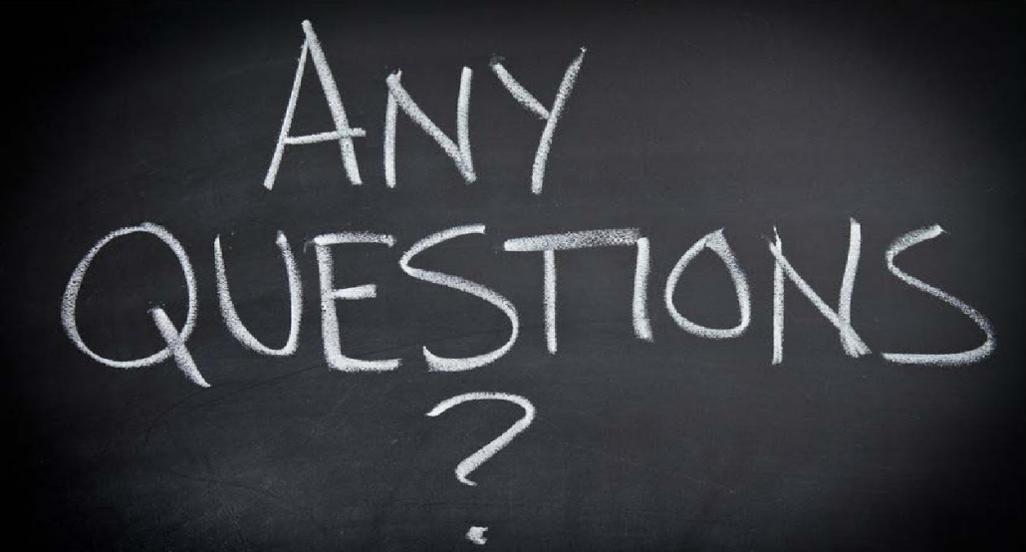
Thank you !

